Slide 1


Android operating system
UNDER THE GUAIDANCE OF
SUMA LAKSHMI MAM

Slide 2
TEAM MEMBERS
ROLL NUMBERS NAMES
2110030350 ALUGALA VINAY KUMAR
2110030437 GATTU SAICHARN
2110030373 NUTHULLA SRIJAAN

Slide 3
CONTENTS
1. WHAT IS ANDROID? 16.GitHub
2. HISTORY
3. FEATURES
4. GOOGLE ANDROID
5. BLUETHOOT TECHNOLOGY
6. Wi-Fi
7. Commonly used packages in android OS.
8. Android – Software
9. Android – Applications
10.Building and running app
11. Application on android
12. Software features
13.Hardware features
14.Advantages
15.Disadvantages

Slide 4
WHAT IS ANDROID ?
Android is an open source operating system, created by Google specifically for use on mobile devices (cell phones and tablets).
Linux based (2.6 kernel).
Android apps can be programmed in C/C++ but most application development is done in Java (Java access to C Libraries via JNI (Java Native Interface)).
Android OS supports Bluetooth, Wi-Fi, and 3G, 4G and 5G networking.

Slide 5
HISTORY
2005
Google acquires start up Android Inc. to start Android platform
Work on Dalvik, VM begins
2007
Open Handset Alliance announced
Early look at SDK
2008
Google sponsors 1st Android Developer Challenge
T-Mobile G1 announced
SDK 1.0 released
Android released open source (Apache License)
Android Dev Phone 1 released

Slide 6
2009
SDK 1.5 (Cupcake)
New soft keyboard with "autocomplete" feature
SDK 1.6 (Donut) • Support Wide VGA
SDK 2.0/2.0.1/2.1 (Eclair)
Revamped Ul, browser
2010
Nexus One released to the public
SDK 2.2 (Froyo)
Flash support, tethering
SDK 2.3 (Gingerbread)
Ul update, system-wide copy-paste

Slide 7
2011
SDK 3.x (Honeycomb)
Optimized for tablet support
SDK 4.0 (Ice Cream Sandwich) o Virtual UI buttons
2012
SDK 4.1.1 (Jelly Bean)
Triple buffered graphics pipeline

Slide 8
FEATURES
Configuration of the Smartphone Platform
3G/4G connectivity
Wi-Fi connectivity
Bluetooth connectivity
Accelerometer w/compass
Ambient light sensor
Proximity sensor
GPS
Gyroscope

Slide 9
GOOGLE ANDROID
A software stack for mobile devices that
includes . An operating system
Middleware
Key Applications
Uses Linux to provide core system services
Security
Memory management
Process management
Power management
Hardware drivers

Slide 10
BLUETOOTH TECHNOLOGY
Open wireless technology
Developed by Ericsson (1994)
Originally supposed to replace wired RS-232
Short distance via low power, short distance radio
Allows creation of personal area networks
->Mostly to connect wireless peripheral devices to a host
->Computer (mice, headsets, microphones, keyboard)
Can also be used to communicate between two host computers wirelessly (replace serial cables)

Slide 11
Wi-Fi
Used to brand certified products that belong to a class of wireless local area network based on
IEEE Standard 802.11.
Currently there are 3 versions of 802.11 in common use:
-> B, about 150 feet indoors, 300 ft outdoors
->G, 54 Mbits about 150 feet indoors, 300 ft outdoors
->N, 600 Mbits, about 1.5 miles in open air, uses MIMO
->(multiple input and output antennas)

Slide 12
COMMONLY USED PACKAGES IN ANDROID OS
User interface layout
Secure networking and web browsing
Structured storage and relational databases
(SQLite RDBMS)
2D and 3D Graphics SGL and OpenGL
Audio and visual media support
Access to optional hardware (GPS)

Slide 13
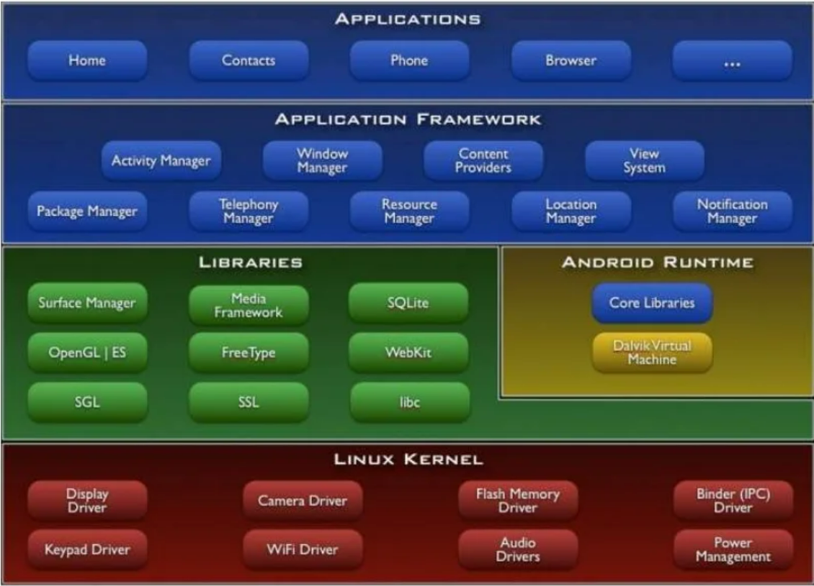
ANDROID –SOFTWARE PACK

Slide 14
ANDROID APPLICATIONS
Built using Java and new SDK libraries
->No support for some Java libraries like Swing & AWT
Java code compiled into Dalvik byte code (.dex)
-> Optimized for mobile devices (better memory management, battery utilization, etc.)
Dalvik VM runs .dex files

Slide 15
ANDROID APPLICATIONS
By default, each app is run in its own Linux process
->Process started when app's code needs to be executed
->Threads can be started to handle time consuming operations
Each process has its own Dalvik VM
By default, each app is assigned unique Linux ID
-> Permissions are set so app's files are only visible to that app

Slide 16
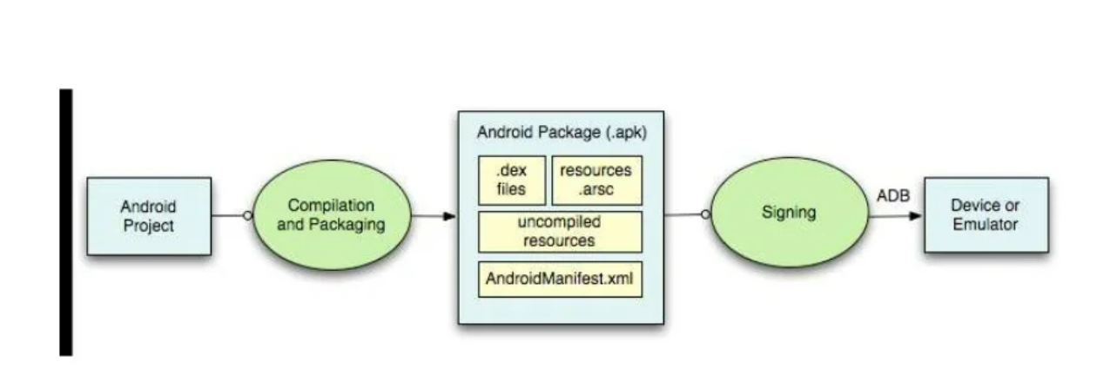
BUILDING AND RUNNING AN APP
ADB is a client server program that connects clients on developer machine to devices/emulators to facilitate development. An IDE like Eclipse handles this entire process for you.

Slide 17
SOFTWARE FEATURES
Integrated browser based on the open source Web Kit engine
SQLite for relational data storage
Media support for common audio, video, and still image formats
Dalvik Virtual Machine optimized for mobile devices

Slide 18
HARDWARE FEATURES
Cellular networking: GSM, EDGE, 3G
LAN: Bluetooth, and Wi-Fi
Graphics Hardware Acceleration
Camera, GPS and Compass
Touch screen and accelerometer for motion sensing

Slide 19
ADVANTAGES
Always with the user
Typically have Internet access
Typically GPS enabled
Typically have accelerometer & compass
Most have cameras & microphones
Many apps are free or low-cos

Slide 20
DISADVANTAGES
Limited screen size
Limited battery life
Limited processor speed
Limited and sometimes slow network access
Limited or awkward input: soft keyboard, phone keypad, touch screen, or stylus
Limited web browser functionality
Range of platforms & configurations across devices

Slide 21
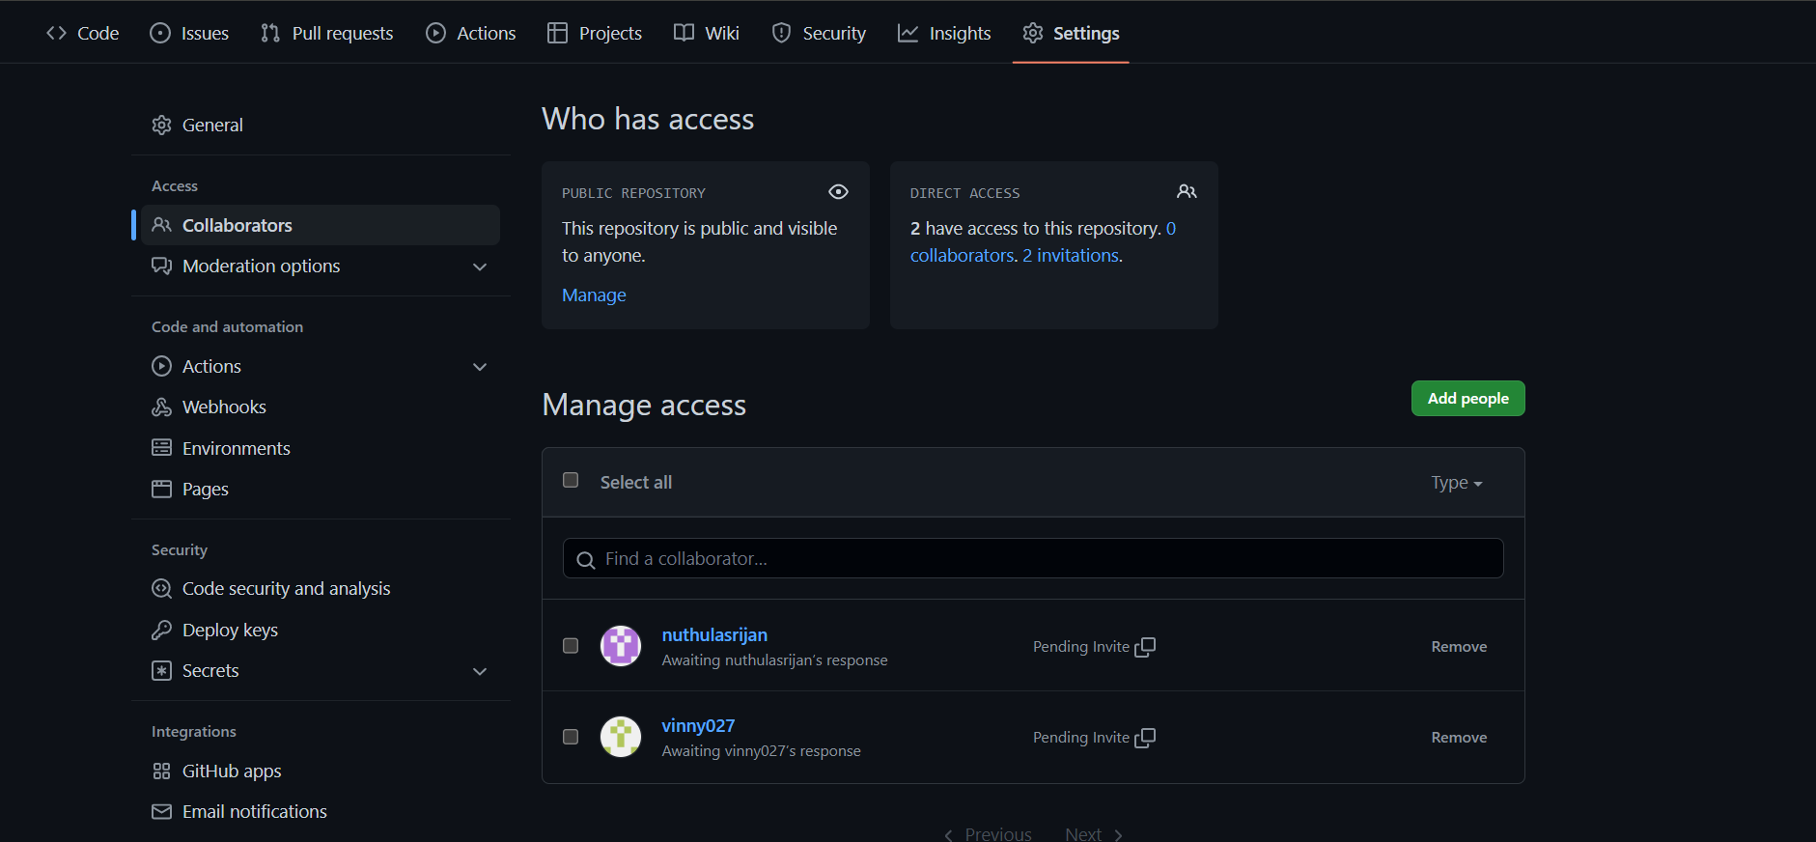
GITHUB

Slide 22
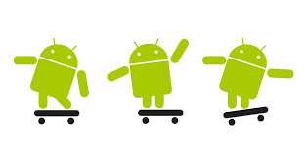


THANK YOU..

